Slide 1
The electron microscope

Slide 2
Features of the electron microscope
Electron beam has short wavelength so it can resolve objects well
Electrons are negatively charged so the beam is focused using electro magnets
Modern electron microscopes can resolve objects 0.1 nm apart and magnify up to 500 000 times

Slide 3
Transmission electron microscope (TEM)
Specimen is specially prepared
Thin slices of specimen are cut, preserved and stained
Specimen is placed in chamber of the electron microscope. It is sealed and air is sucked out to create a vacuum

Slide 4
Transmission electron microscope (TEM)
Electromagnets focus a beam of electrons that passes through the specimen onto a viewing screen
Parts of the specimen absorb electrons so appear dark, other parts allow electrons to pass through so appear light
An image is produced on a screen, this can be photographed to produce a photomicrograph

Slide 5
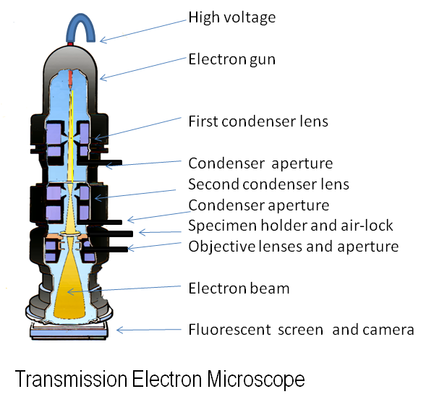

Slide 6
Scanning electron microscope (SEM)
Specimen doesn’t need to be as thin
Beam of electrons scans over rectangular area of sample surface
Resolution from 1 – 20 nm

Slide 7
SEM - ant

Slide 8
SEM – blood cells

Slide 9
TEM - chloroplast

Slide 10
TEM - mitochondria

Slide 11
SEM – fish gills

Slide 12
SEM – fungal spore stalk emerging from stomata

Slide 13
TEM – endoplasmic reticulum

Slide 14
SEM – spider’s silk spigots

